Slide 1

Workshop on “Neurons to Networks: Unleashing the Power of Brain-Inspired AI”
Modeling a Cerebellum Inspired Spiking Neural Network (CISNN) using Matlab for Motor control
Dr. Asha Vijayan
Assistant Professor (Sl. Gr)
Mind Brain Center
Amrita University
ashavijayan@am.amrita.edu
14-03-2025

Slide 2
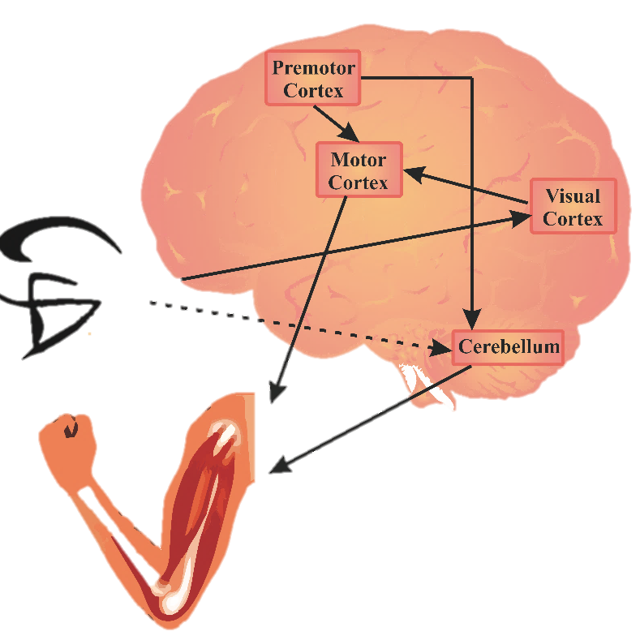
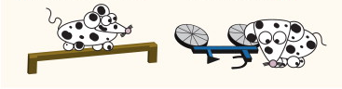
Neuroscience of Motor Control
Motor movement initiation happens in motor cortex but timing of these movements is fine-tuned by cerebellum
Areas involved in MC
Primary motor cortex
Sensory motor cortex
Visual Cortex
Cerebellum
Basal ganglia
Spinal cord
Muscles
Motor Performance
Motor Error
Galliano E, Gao Z, Schonewille M, Todorov B, Simons E, Pop AS, D’Angelo E, Van Den Maagdenberg AMJM, Hoebeek FE, De Zeeuw CI (2013) Silencing the Majority of Cerebellar Granule Cells Uncovers Their Essential Role in Motor Learning and Consolidation. Cell Rep 3:1239–1251.

Slide 3
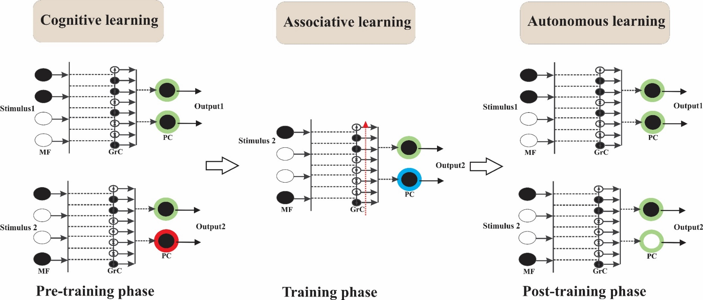
Stages of Motor Learning
Motor learning involves 3 stages of learning:
Cognitive, Associative and Autonomous (Fitts and Posner, 1967)
Fitts, P.M., & Posner, M.I. (1967). Human performance. Oxford, England: Brooks/Cole.

Slide 4
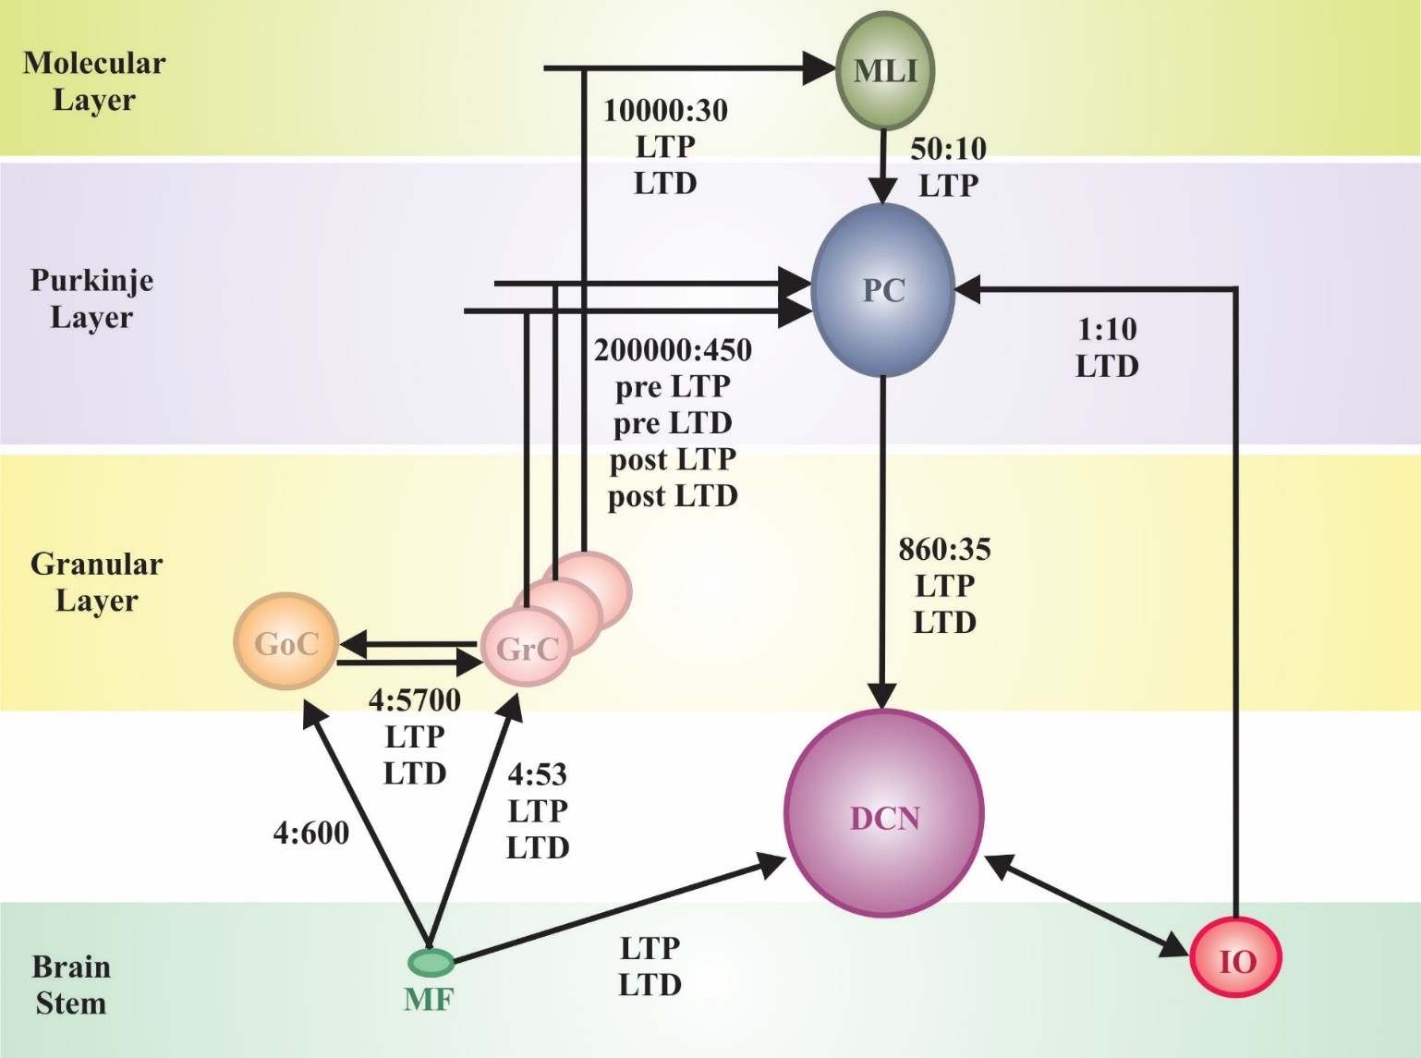
Cerebellar Microcircuitry for Motor Learning

Slide 5
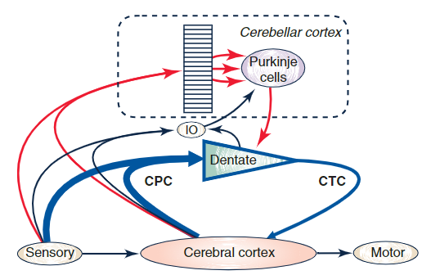
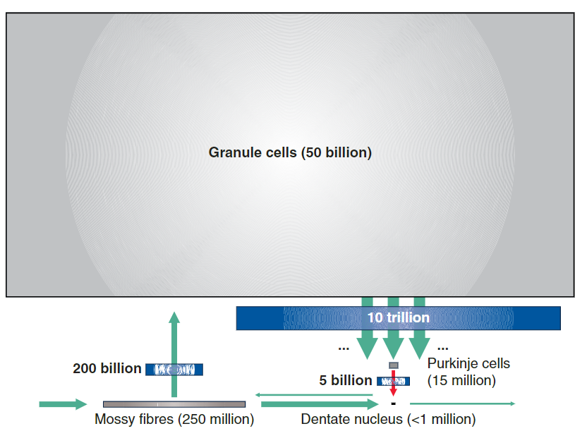
Marr Albus Ito Theory
Marr's computational insights- error based learning
Albus's theoretical framework- supervised learning
Ito's experimental findings-synaptic plasticity.
Cerebellum functions as a predictive controller
generates internal models of body dynamics,
learns from sensory feedback
refine motor commands,
adapts movements through synaptic plasticity.
Sanger et.al.,2020
250 million MF
50 billion GrC
15 million PC
1 million DCN
Sanger, T.D., Yamashita, O. and Kawato, M. (2020), Expansion coding and computation in the cerebellum: 50 years after the Marr–Albus codon theory. J Physiol, 598: 913-928. https://doi.org/10.1113/JP278745

Slide 6
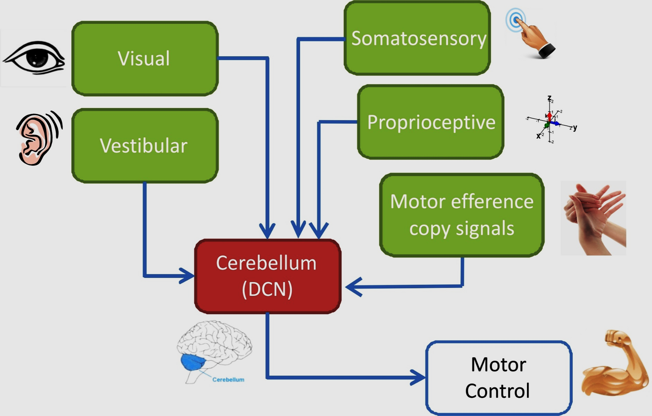
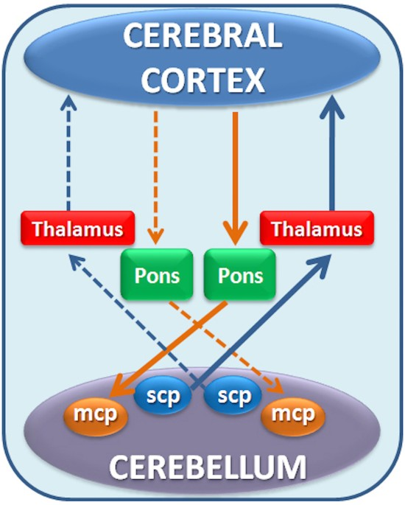
Sensory perception in cerebellum
Rajendran et.al.,2021
Rajendran A, Vijayan A, Chaitanya M, Nair B, Diwakar S., Computational Modelling of Cerebellum Granule Neuron Temporal Responses for Auditory and Visual Stimuli, International Journal of Advanced Intelligence Paradigms, 2018, 10.1504/IJAIP.2018.10011493.

Slide 7
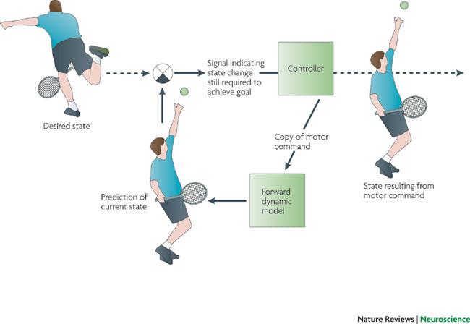
How does cerebellum achieve fine-tuning ?
Noise
Decision making
Motor Command generation
Cerebellum
Movement planning
Coordinate transformation
To develop a comprehensive theory of sensorimotor learning and control, it is crucial to determine the neural basis of coding and plasticity embedded into cerebellar neural circuit.
Error processing
Motor Control
Schaal S, Schweighofer N (2005) Computational motor control in humans and robots. Curr Opin Neurobiol 15:675–682.

Slide 8
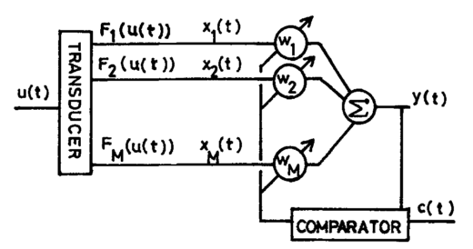
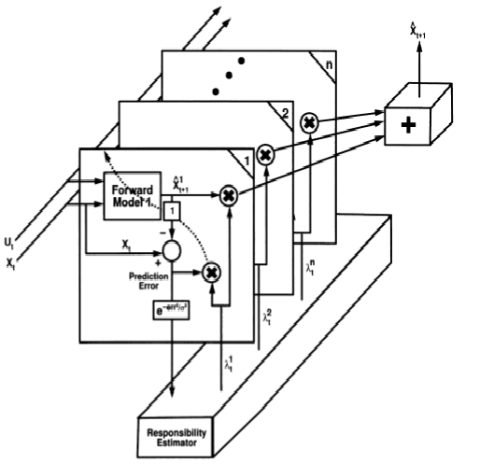
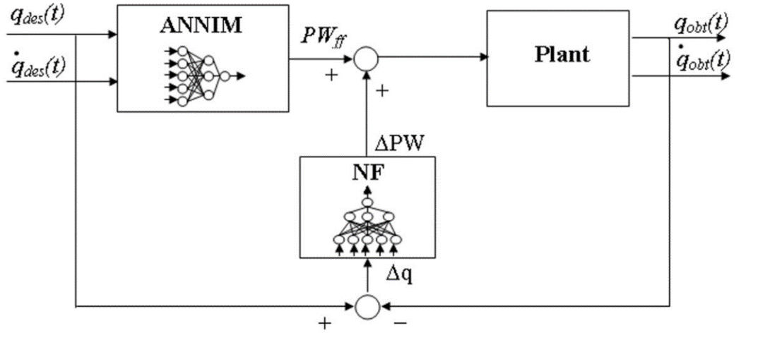
Cerebellum based Mathematical Models for Control
Adaptive filter model (Fujita et.al., 1982)
Multipaired model of forward inverse model (Kawato et.al., 1992)
Error mapping controller (Pedrocchi 2006)
Fujita M (1982) Adaptive filter model of the cerebellum. Biol Cybern 45:195–206
Kawato M, Gomi H (1992) The cerebellum and VOR/OKR learning models. Trends Neurosci 15:445–453.
Pedrocchi A, Ferrante S, De Momi E, Ferrigno G (2006) Error mapping controller: a closed loop neuroprosthesis controlled by artificial neural networks. J Neuroeng Rehabil 3:1–13

Slide 9
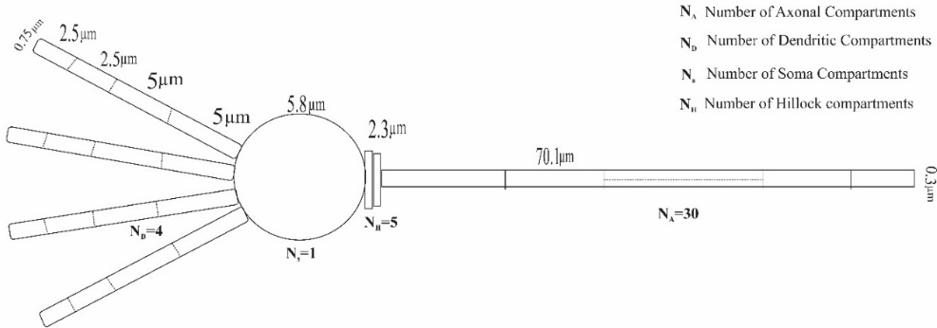
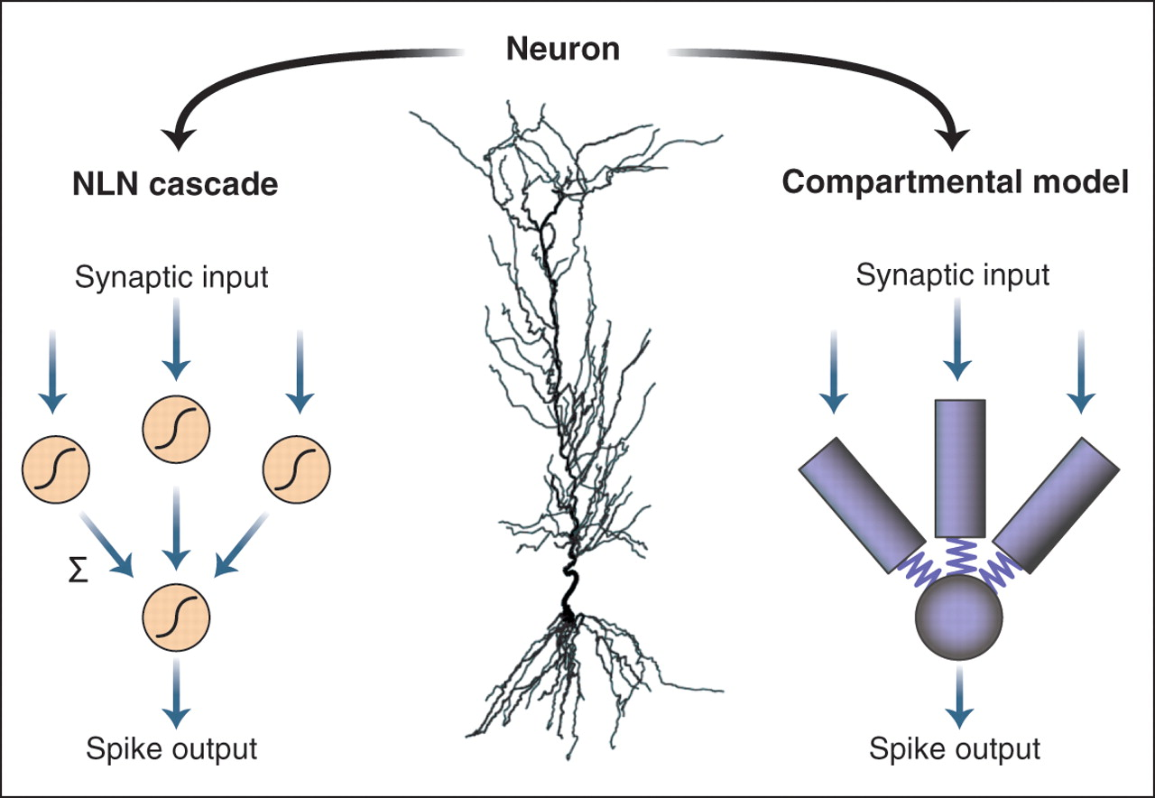
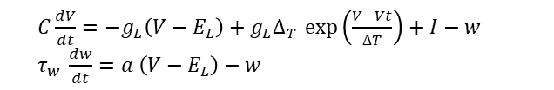
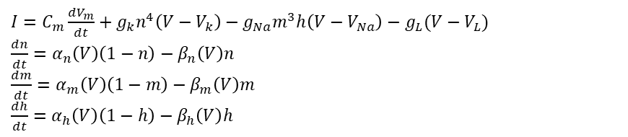
Computational neuroscience to mathematical modeling
$I=C_{m}\frac{dV_{m}}{dt}+g_{k}n^{4}\left(V−V_{k}\right)−g_{Na}m^{3}h\left(V−V_{Na}\right)−g_{L}(V−V_{L})$
$\frac{dn}{dt}=α_{n}\left(V\right)\left(1−n\right)−β_{n}\left(V\right)n$
$\frac{dm}{dt}=α_{m}\left(V\right)\left(1−m\right)−β_{m}\left(V\right)m$
$\frac{dh}{dt}=α_{h}\left(V\right)\left(1−h\right)−β_{h}\left(V\right)h$
(Hodgkin and Huxley,1952)
$C\frac{dV}{dt}=−g_{L}\left(V−E_{L}\right)+g_{L}∆_{T }\exp\left(\frac{V−Vt}{∆T}\right)+I−w$
$τ_{w }\frac{dw}{dt}=a \left(V−E_{L}\right)−w$
(Naud et.al.,2008)
Andreas V. M. Herz et al. ,Modeling Single-Neuron Dynamics and Computations: A Balance of Detail and Abstraction. Science314,80-85(2006).DOI:10.1126/science.1127240
Hodgkin AL, Huxley AF (1952) A quantitative description of membrane current and its application to conduction and excitation in nerve. J Physiol 117:500–544
Naud R, Marcille N, Clopath C, Gerstner W (2008) Firing patterns in the adaptive exponential integrate-and-fire model. Biol Cybern 99:335–347.

Slide 10
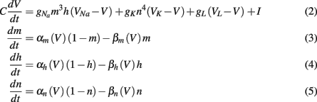
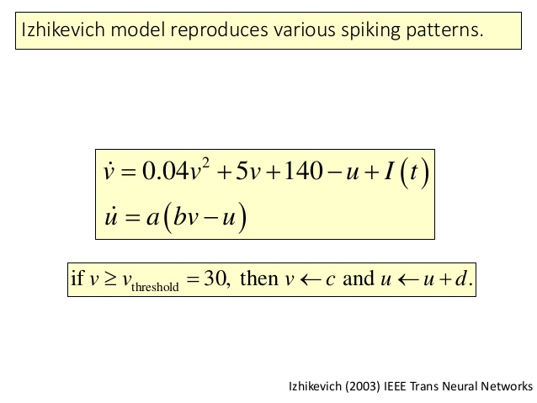
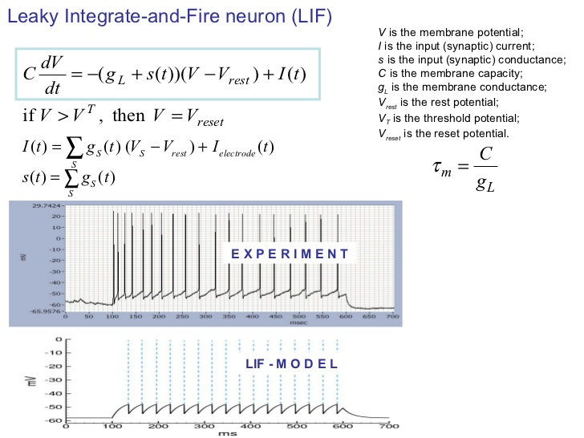
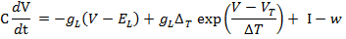
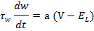
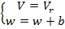
Neuron models
Hodgkin Huxley model
Izhikevich model
Hodgkin & Huxley (1952),J.Physiol
Time and voltage-dependent variables are included
Leaky Integrate and Fire model
Adaptive Exponential Integrate and Fire model
If V> 0 mV then

Slide 11
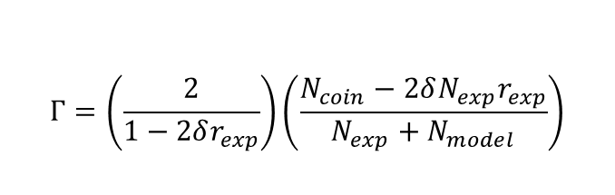
Fitting Data to Models
Parameter | Values |  |  |  |  | Description
 | GrC | GoC | PC | IO | DCN
C | 150 | 500 | 100 | 350 | 200 | Membrane Capacitance
g_{L} | 10 | 13.1 | 10 | 10 | 10 | Leak Conductance
E_{l} | -70 | -58 | -65 | -65 | -70 | Reversal Potential
ΔT | 4 | 7 | 2 | 2 | 2 | Slope Factor
Vt | -50 | -54 | -50 | -50 | -50 | Threshold Voltage
τ_{w} | 13 | 8.7 | 1 | 1 | 8 | Adaptation time constant
I | 350 | 0 | 0 | 0 | 0 | Injected Current
A | 9 | -17 | -13 | -13 | -20 | Subthreshold adaptation
B | 250 | 1033 | 260 | 1200 | 675 | Spike-triggered adaptation
Coupled equations
Reset function
If V> 0 mV then
Optimisation
PSO Algorithm
Medini et.al.,2014
$$Γ=\left(\frac{2}{1−2δr_{exp}}\right)\left(\frac{N_{coin}−2δN_{exp}r_{exp}}{N_{exp}+N_{model}}\right)$$
Coincidence detection
Medini C., Vijayan A., D'Angelo E., Nair B. and Diwakar S. Computationally Efficient Biorealistic Reconstructions of Cerebellar Neuron Spiking Patterns, Proceedings of International Conference on Interdisciplinary Advances in Applied Computing , Amrita University, Coimbatore, India, October 10-11, 2014.

Slide 12

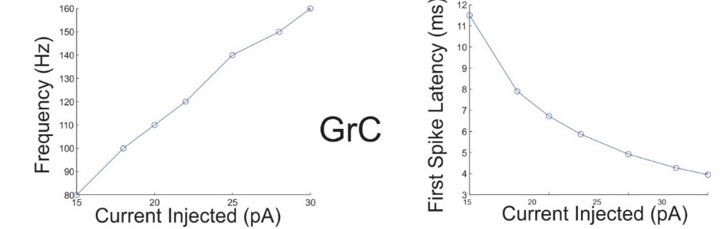
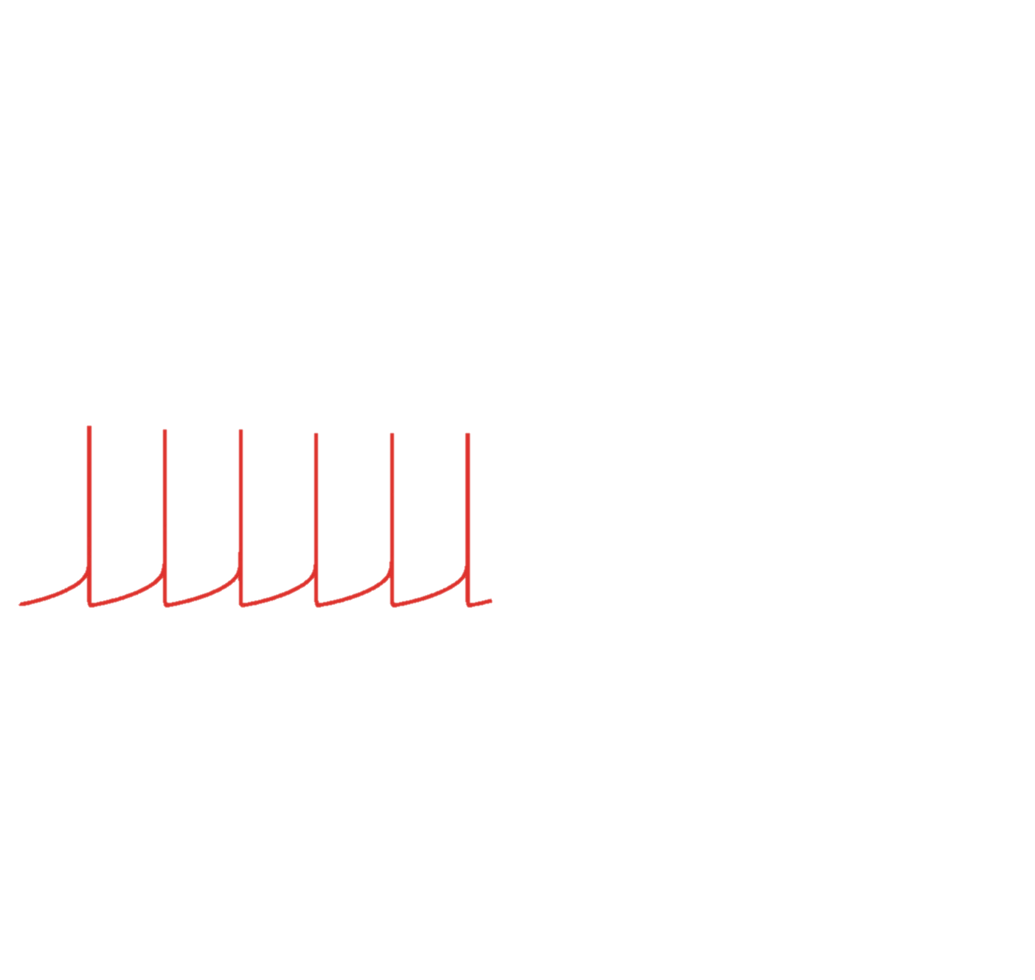

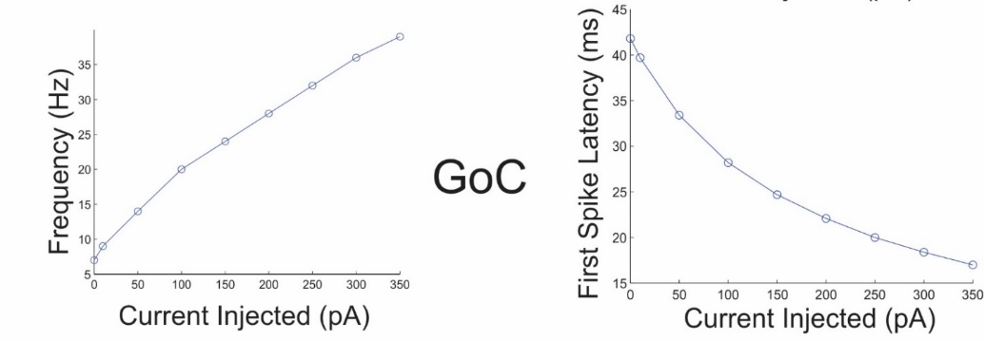

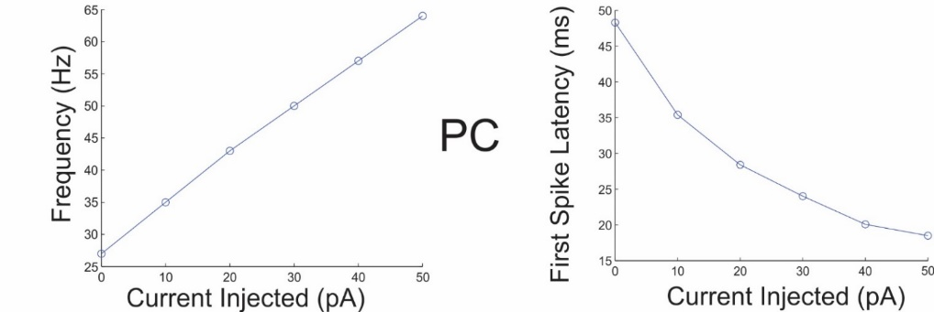
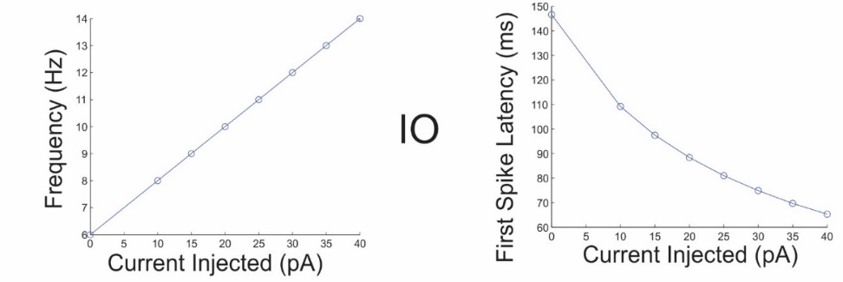
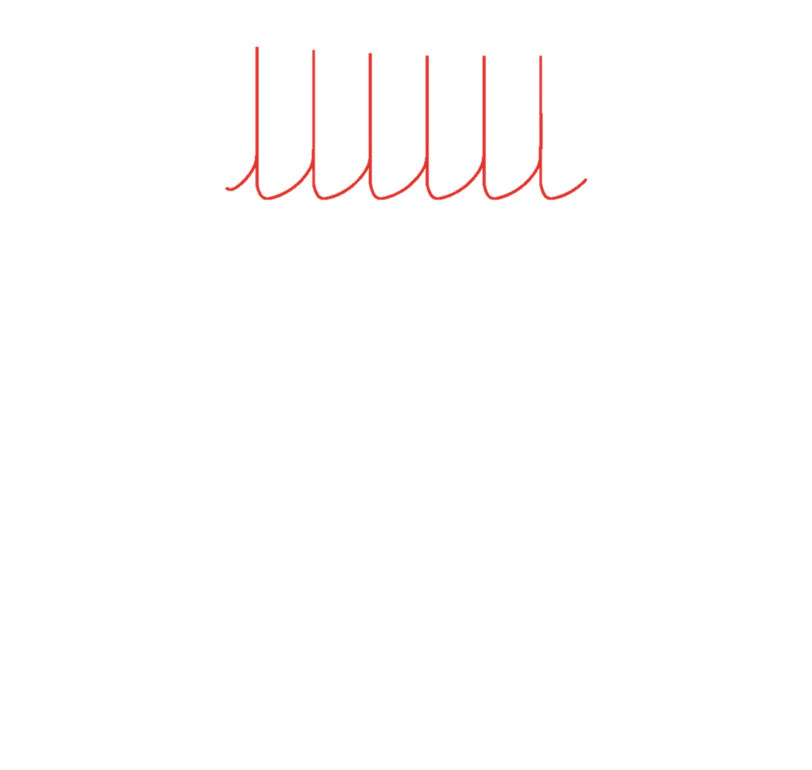
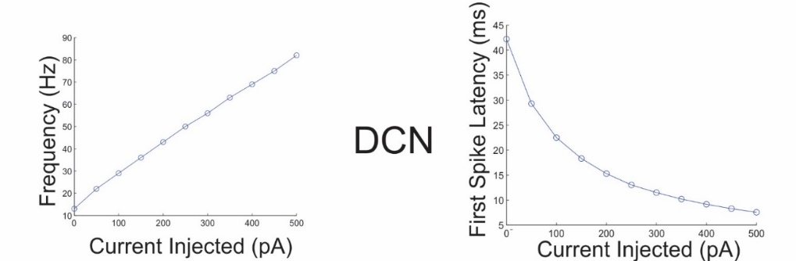
Modeling electro-responsiveness properties of cerebellar neurons
Inferior Olivary Nuclei
Medini et.al.,2014

Slide 13
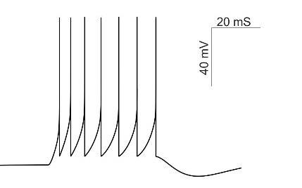
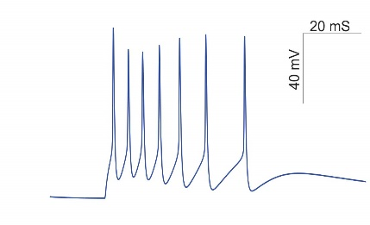
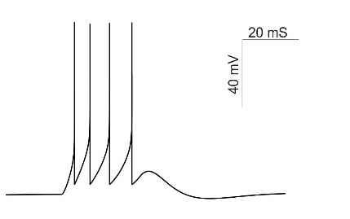
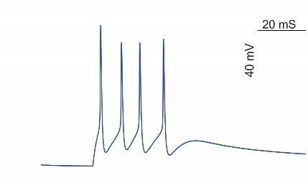
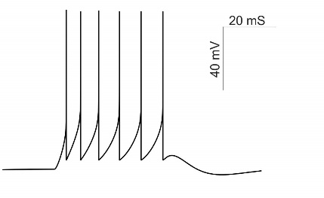
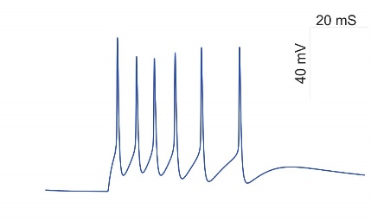
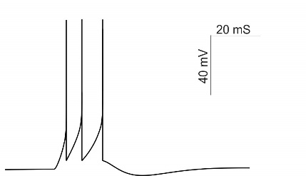
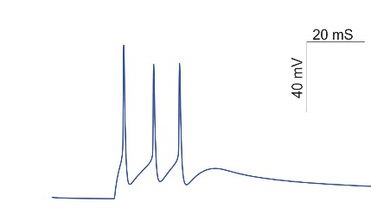
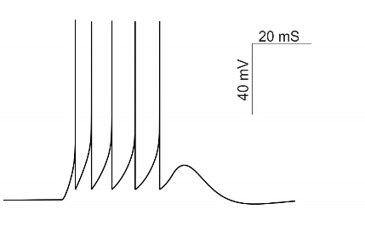
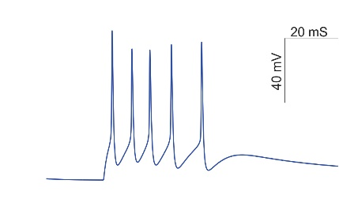
Capturing the repertoire of firing in Granule Cells
4E 0I
4E 3I
4E 1I
4E 4I
4E 2I
Medini et.al.,2014
Medini C., Vijayan A., D'Angelo E., Nair B. and Diwakar S. Computationally Efficient Biorealistic Reconstructions of Cerebellar Neuron Spiking Patterns, Proceedings of International Conference on Interdisciplinary Advances in Applied Computing , Amrita University, Coimbatore, India, October 10-11, 2014.

Slide 14
Hands-on with Matlab
Create single neurons of the cerebellum
Granule cell
Purkinje cell

Slide 15
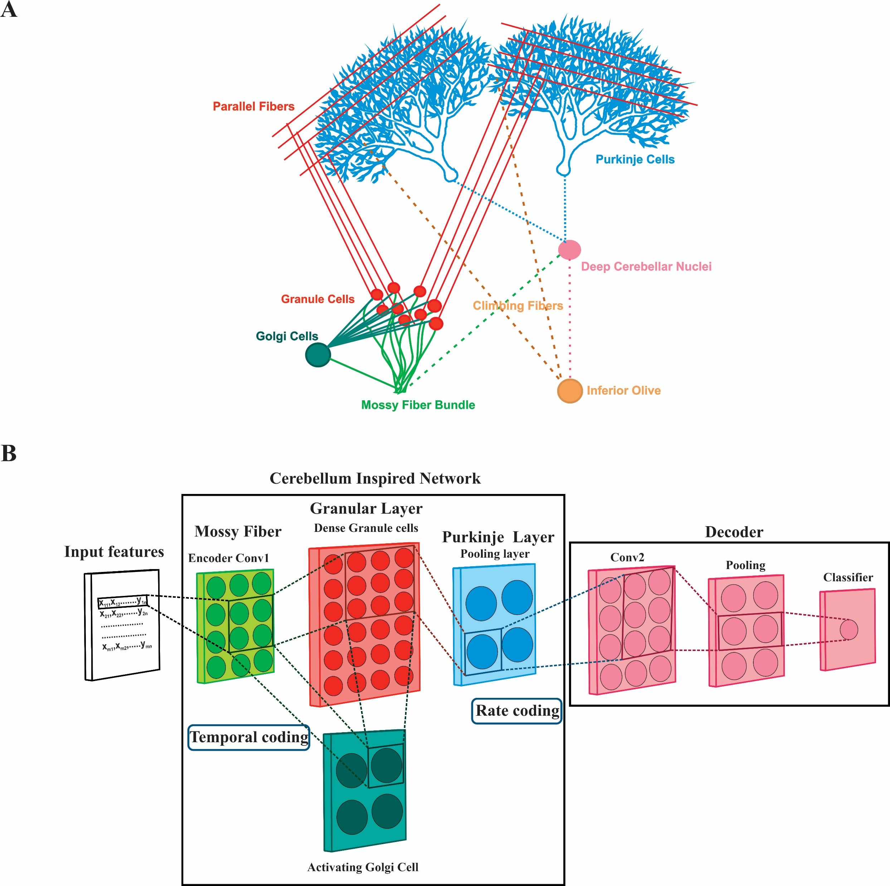

From Biology to Mathematical Abstraction
Cerebellar microcircuitry
DLCISNN
Vijayan et.al.,2022

Slide 16
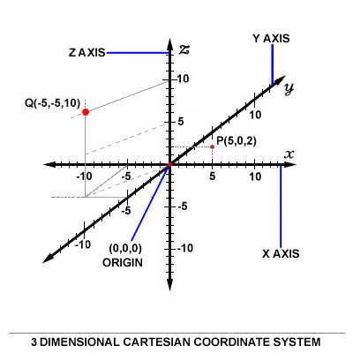
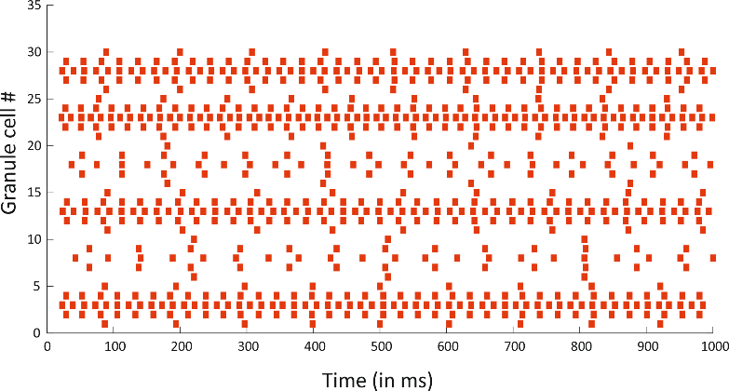
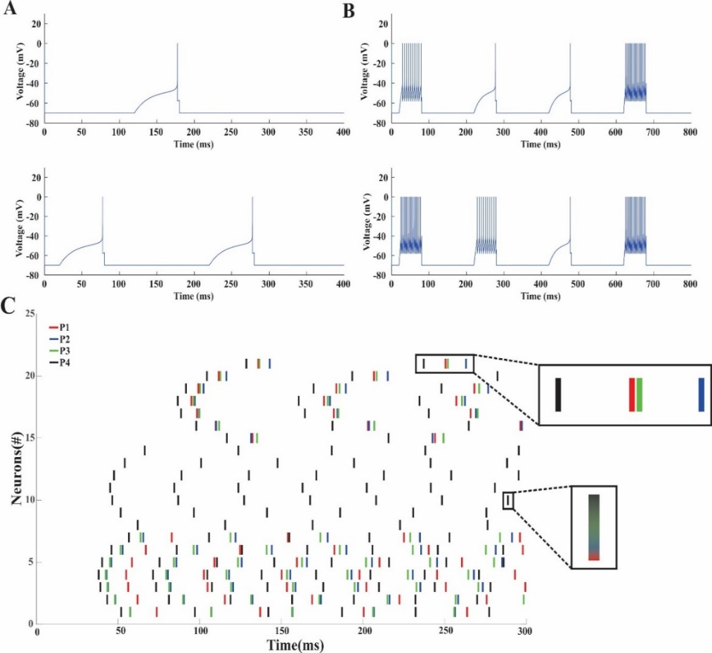
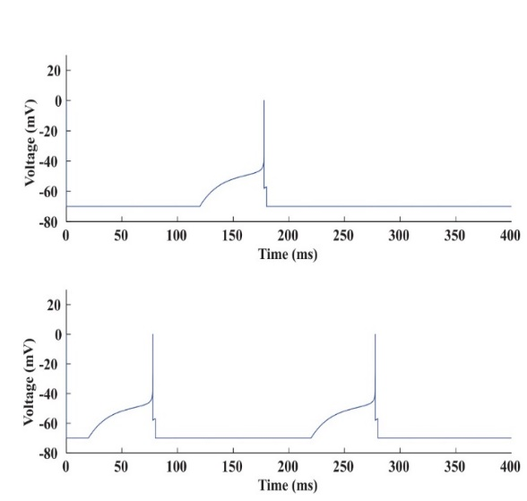
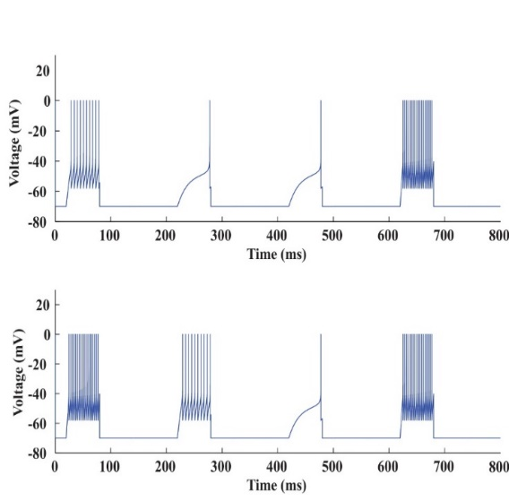
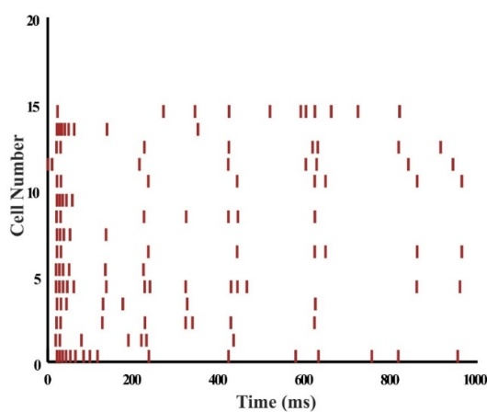
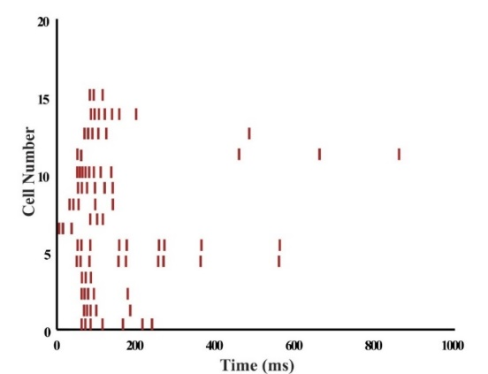
Encoding of real-world data into multimodal sensory information
Vijayan et.al.,2022
Gaussian kernel based encoding
Stimulus
Response
Medini et.al.,2015
Visual stimuli
Auditory stimuli
One hot encoding
 | Visual | Auditory
4E 0I | 9 | 14
4E 4I | 5 | 6
BSA encoding
Granular Layer Encoding
Rajendran et.al.,2021

Slide 17
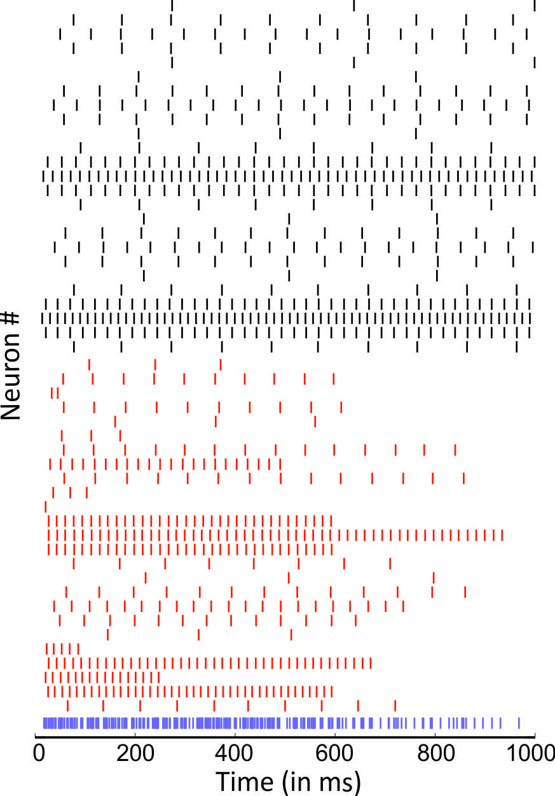
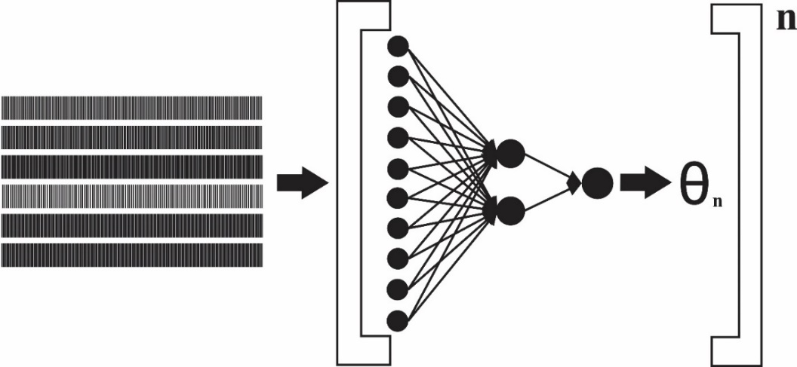


Decoding back to real-world data
Time bins
1 | 0 | 2 | 1
2 | 3 | 1 | 1
0 | 1 | 2 | 3
Spike trains
Kernel matrix
$$y=\sum{x_{i}w_{i}}$$
$$f\left(y\right)=\frac{1}{1+e^{−y}}$$
Transformation

Slide 18

From single neurons to network firing properties of cerebellar microcircuitry

Slide 19

From single neurons to network firing properties of cerebellar microcircuitry
Mossy fiber: Using a Spike generator random spike trains were generated

Slide 20

From single neurons to network firing properties of cerebellar microcircuitry
Granule cell: Some of the neurons remain in quiescent state

Slide 21

From single neurons to network firing properties of cerebellar microcircuitry
Purkinje cell: Firing increases with Grc input

Slide 22



Learning rule implementation for the model
HTP algorithm
Medini et.al.,2015
Hebbian learning
Vijayan et.al.,2022
FP algorithm
Vijayan et.al.,2015

Slide 23


Characterization of cerebellar neurons for perceiving adaptation
MF-GrC adaptation
GrC firing behaviour before and after learning
Mean GrC firing rate before and after learning
MF-GrC synapse shows a slow learning rate during training implying a smaller weight change
Vijayan et.al.,2022

Slide 24




Characterization of cerebellar neurons for perceiving adaptation
GrC firing behaviour before and after learning
Mean GrC firing rate before and after learning
Mean PC firing rate before and after learning
PF-PC synapse shows a increase in firing during training implying a diverse weight change
PC firing behaviour before and after learning
MF-GrC adaptation
Vijayan et.al.,2022

Slide 25

Acquiring data employing a Robotic Simulator
Vijayan et.al.,2013

Slide 26
Abstraction for Robotics and Neuroprosthesis
Vijayan et.al.,2013

Slide 27

Quantitative measure of information: Sparseness and Storage Capacity
Sparseness Index:
$SI=\frac{1−A}{1−\frac{1}{n}}$
Where $A=\frac{{(\sum_{1}^{n}{{v_{i}}/n)}}^{2}}{\sum_{1}^{n}{({{v_{i}}^{2}}/n)}}$
$S=\left\{\begin{aligned}0 when v_{i}=v for all i (A=1) \\ 1 when v_{i}=v and v_{j≠i}=0 (A=\frac{1}{n})\end{aligned}\right.$
Storage capacity:
To quantify the number of input output associations that can be stored in the synapses
$α_{c}=\frac{lnlnK}{2ln2}$
$\frac{T}{N_{τ}}=α_{c}(r_{out}τ)$
Vijayan et.al.,2022

Slide 28




Quantitative measure of information: Sparseness and Storage Capacity
Sparseness Index:
$SI=\frac{1−A}{1−\frac{1}{n}}$
Where $A=\frac{{(\sum_{1}^{n}{{v_{i}}/n)}}^{2}}{\sum_{1}^{n}{({{v_{i}}^{2}}/n)}}$
$S=\left\{\begin{aligned}0 when v_{i}=v for all i (A=1) \\ 1 when v_{i}=v and v_{j≠i}=0 (A=\frac{1}{n})\end{aligned}\right.$
Storage capacity:
To quantify the number of input output associations that can be stored in the synapses
$α_{c}=\frac{lnlnK}{2ln2}$
$\frac{T}{N_{τ}}=α_{c}(r_{out}τ)$
Sparseness before learning
Sparseness after learning
Vijayan et.al.,2022
Both generalization and learning interference were observed after learning and was analysed using Sparseness index

Slide 29






Information storage at synapses based on parametric values
Purkinje cell
Granule cell
τ_{m}= 64 ± 17ms
(Roth & Hausser,2001)
Firing rate
Firing rate
5 PF-PC synapses were needed for reproducing desired behavior.
Vijayan et.al.,2015, 2022
α for PC between 0.1 and 0.3
Stability constant
Stability constant
Vijayan, A. et.al.,Modeling Pattern Abstraction in Cerebellum and Estimation of Optimal Storage Capacity, in Proceedings of the Fourth International Conference on Advances in Computing, Communications and Informatics (ICACCI-2015), Kochi, India, 2015.

Slide 30

Robotic abstraction using Cerebellum inspired network

Slide 31

Case Study on Robotic abstraction
Cerebellar circuit was reconstructed with:
21 Mossy fibers
279 Granule cells
6 Purkinje cell
Total of 306 neurons
 | Convergence | Divergence
MF-Grc | 53 | 4
PF-PC | --- (20000) | 49 (80000)

Slide 32
Classification of robotic arm data using standard machine learning algorithms
Vijayan et.al.,2013
Machine learning algorithms to predict robotic arm articulation
A. Vijayan, C. Medini, H. Singanamala, C. Nutakki, B. Nair, and S. Diwakar, “Classification of Robotic Arm Movement using SVM and Naïve Bayes Classifiers,” in Proceedings of Third International Conference on Innovative Computing Technology (INTECH 2013), 2013, pp. 263–268.

Slide 33
Classification of robotic arm data using standard machine learning algorithms
Vijayan et.al.,2013
Machine learning algorithms to predict robotic arm articulation
A. Vijayan, C. Medini, H. Singanamala, C. Nutakki, B. Nair, and S. Diwakar, “Classification of Robotic Arm Movement using SVM and Naïve Bayes Classifiers,” in Proceedings of Third International Conference on Innovative Computing Technology (INTECH 2013), 2013, pp. 263–268.

Slide 34
Classification of robotic arm data using standard machine learning algorithms
Vijayan et.al.,2013
Machine learning algorithms to predict robotic arm articulation
A. Vijayan, C. Medini, H. Singanamala, C. Nutakki, B. Nair, and S. Diwakar, “Classification of Robotic Arm Movement using SVM and Naïve Bayes Classifiers,” in Proceedings of Third International Conference on Innovative Computing Technology (INTECH 2013), 2013, pp. 263–268.

Slide 35



Efficacy and Complexity of CISNN on machine learning datasets
Sl.No | Dataset | Features(#) | Instances(#) | Tr.time(s) | Tr.accuracy (%) | T.time(s) | T.accuracy (%)
1 | Autism Spectrum Disorder (ASD) (for adults) | 19 | 199 | 109356.43 | 70 | 2975.2 | 70
2 | ASD(for adolescent) | 19 | 98 | 34047.44 | 66 | 2427.65 | 69
3 | ASD(for children) | 19 | 249 | 87081.05 | 60 | 2153.43 | 52
4 | Iris | 4 | 150 | 19928.47 | 46 | 258.18 | 46
5 | Robotic arm | 9 | 40 | 3919.16 | 61 | 170 | 60
6 | Play tennis | 4 | 14 | 971.86 | 66 | 27.00 | 80
Vijayan et.al.,2022

Slide 36

Trajectory Prediction using Cerebellar Model
Trajectory of robotic arm with 2 datapoints
Distance variability < 3cm
Trajectory of robotic arm with 4 datapoints
Distance variability 7+_4cm
Vijayan et.al.,2017
Validated with weather dataset showed accuracy of 64.30%.

Slide 37

Trajectory Prediction using Cerebellar Model
Error Analysis
Vijayan et.al.,2017

Slide 38

Execution time comparison between Cerebellar Model and Paired Forward Inverse Model
Iteration | Inverse model (s) | Paired inverse forward model (s)
10 | 114.40 | 694.754
30 | 270.8 | 2073.45
50 | 361.03 | 3531.23
70 | 521.72 | 4884.06
100 | 676.18 | 7555.14
Vijayan et.al.,2017

Slide 39





Error Prediction and Cerebellar network model optimisation
Vijayan et.al.,2022
Motor error
Sensory error

Slide 40

Movement prediction using Cerebellum inspired network
Trajectory Learning through CISNN
Trajectory Learning through kinematics
Right
Bodda et.al.,2014
Left

Slide 41

Gait prediction using cerebellum inspired network model

Slide 42




CISNN as a pattern separator for EEG based signals
Spectral activity: relaxed state
Spectral activity: left
Bodda et.al.,2014
Spectral activity: right
Classified as left/ right

Slide 43




Beyond MAI Theory
New cell types
Recurrent loops in and out of cerebellum
Plasticity not only in the PF-PC
Unsupervised and Reinforcement learning in cerebellum
Grc does not only code for sensory motor information but also convey reward expectation
CF -evoked complex spikes can predict upcoming rewards
Multiple forms of learning
Unsupervised Learning
Input pattern
Output
D’angelo et.al.,2016
Reinforcement Learning
Training data
Critic
Schilling K, Oberdick J, Rossi F, Baader SL (2008) Besides Purkinjecells and granule neurons: an appraisal of the cell biology ofthe interneurons of the cerebellar cortex. Histochem Cell Biol130:601–615

Slide 44





www.amrita.edu/mindbrain

